Slide 1

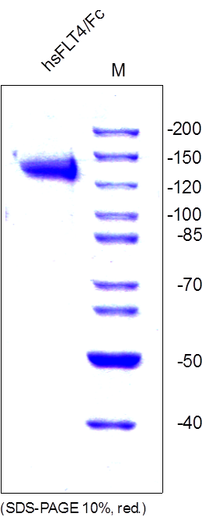
ReliaTech GmbH
Recombinant human soluble FLT-4/Fc Chimera
(Cat #SFC-009 / SFC-010)
Fig. 1: SDS-PAGE analysis of recombinant human soluble FLT4/Fc Chimera derived from insect cells. Sample was loaded in 10% SDS-polyacrylamide gel under reducing conditions and stained with Coomassie blue.
http://www.reliatech.de / orders@reliatech.de

